Slide 1
System/Functional architecture

Slide 2
functional, physical, and system architectures
Example or case study: Mobile phone based voting systems – for national/state elections.
Problem statement: ??
Functional Architecture: Identify and structure the allocated functional and performance requirements.
What are functional requirements?
Of a OS?
Of a school bag?

Slide 3
Example of functional specifications
Business Rules
Transaction corrections, adjustments and cancellations
Administrative functions
Authentication
Authorization levels
Audit Tracking
External Interfaces
Certification Requirements
Reporting Requirements
Historical Data
Legal or Regulatory Requirements

Slide 4
non-functional requirements are
Performance – for example Response Time, Throughput, Utilization, Static Volumetric
Scalability
Capacity
Availability
Reliability
Recoverability
Maintainability
Serviceability
Security
Regulatory
Manageability
Environmental
Data Integrity
Usability
Interoperability

Slide 5
Physical architecture
Depicts the system product as made up of subsystems and components.
Example: all the connected devices in the campus – CPU’s, routers, printers, fax machines, servers --- internet

Slide 6
Examples of system product architecture

Slide 7
MAJOR SECTIONS
There are three major sections inside a mobile phone
Power Section
Radio Section
Computer Section

Slide 8
RADIO SECTION
A radio section has basically a set of four main functions-:
Band Switching
RF Power Amplification
Transmitter
Receiver

Slide 9
COMPUTER SECTION
A computer section consists of two main functions
CPU (central processing unit)
Memory (RAM,FLASH,COMBO CHIP)

Slide 10
TRANSMISSION
MIC
AUDIO IC
RF IC
TX COUPLER
POWER AMPLIFIER
ANTENNA SWITCH
VCO
MODULATION

Slide 11
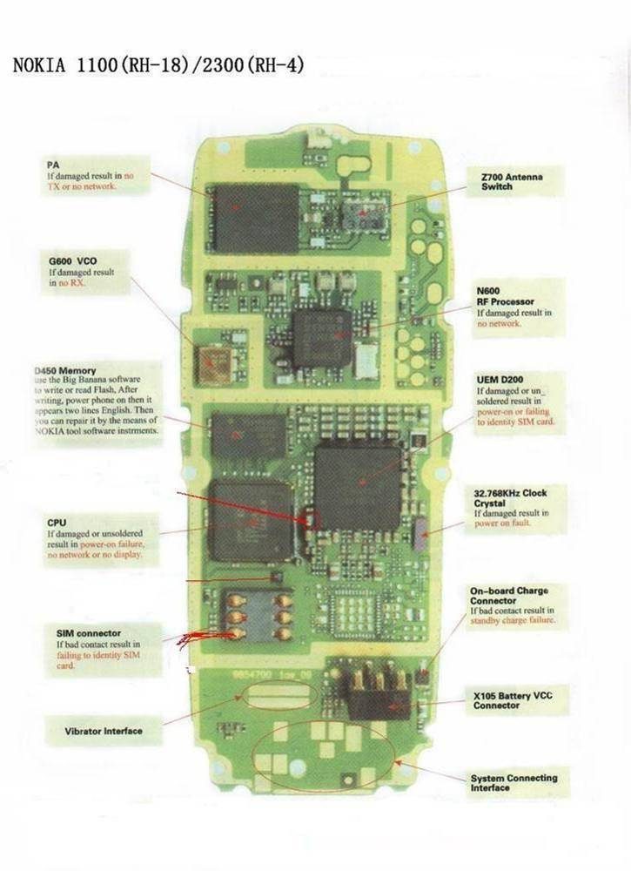

PCB LAYOUT

Slide 12
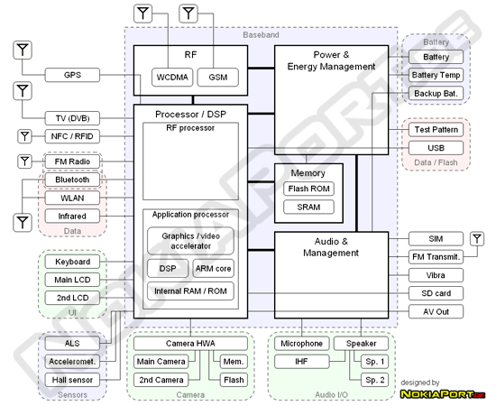

Slide 13
Example- automobile

Slide 14
Main Parameters for an Automobile
Main: Speed, Efficiency, life, accuracy and noise
Dependent parameters: size, shape, mass of the product.
supporting parameters: Acceleration, energy consumption, aerodynamic drag, noise, aesthetics

Slide 15
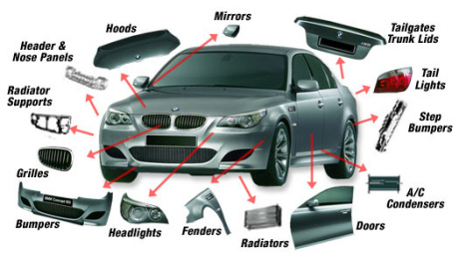
External Parts of a Car - Overview

Slide 16
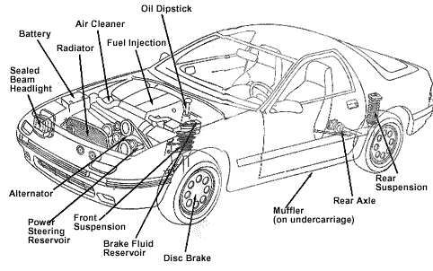
Main internal parts

Slide 17
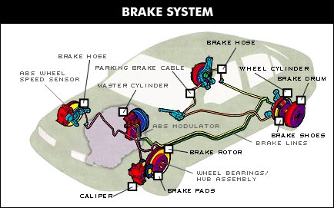
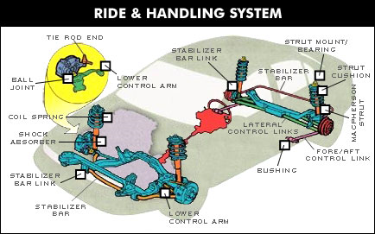
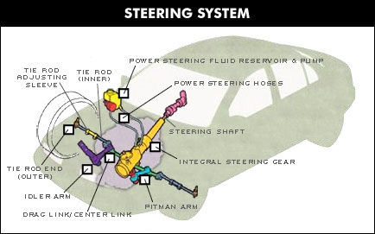
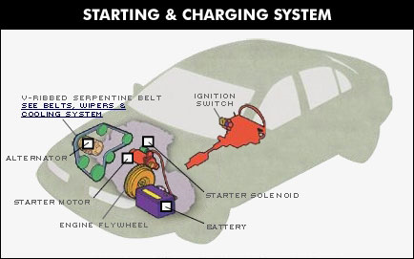

Slide 18
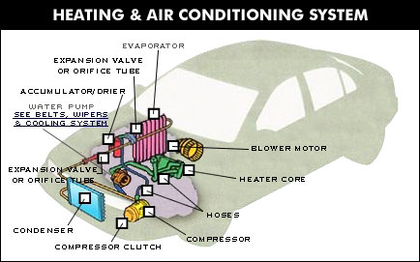
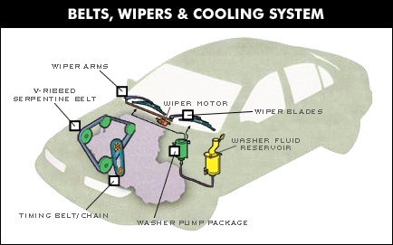
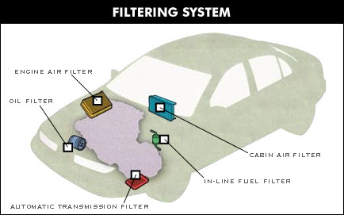
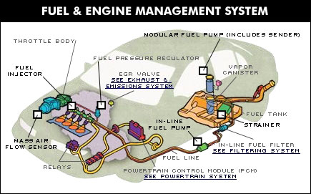

Slide 19
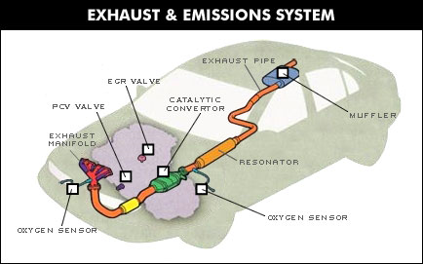
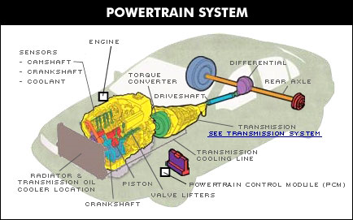
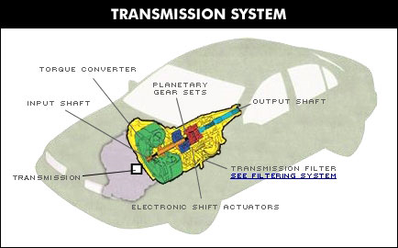

Slide 20
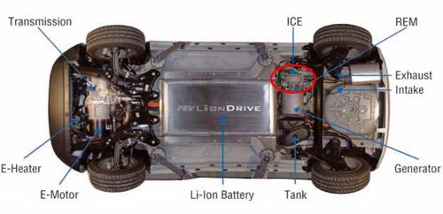
Hybrid

Slide 21
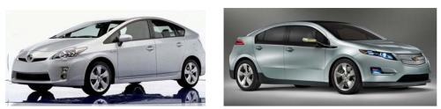
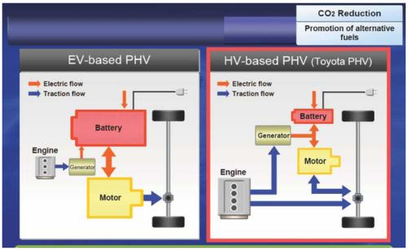
Chevy Volt Vs Toyota Prius
Series Architecture
Parallel & Series Architecture

Slide 22
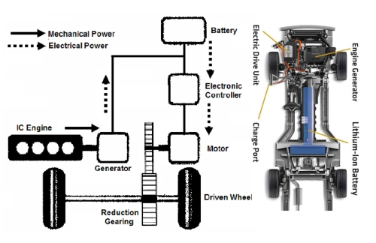
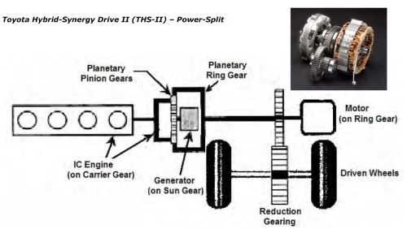
GM Volt
Toyota

Slide 23
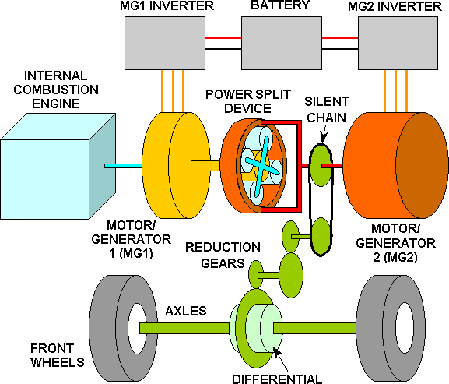
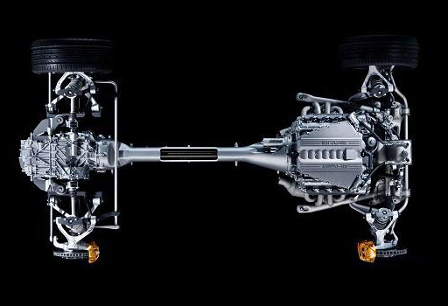
Toyota Pius

Slide 24
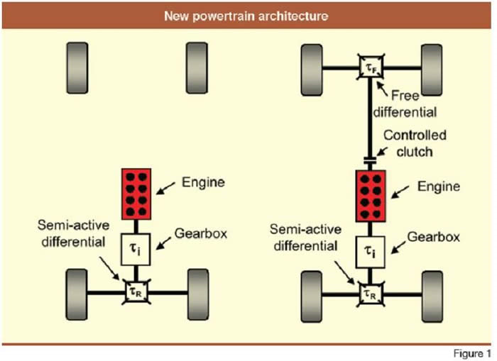
AWD layout

Slide 25
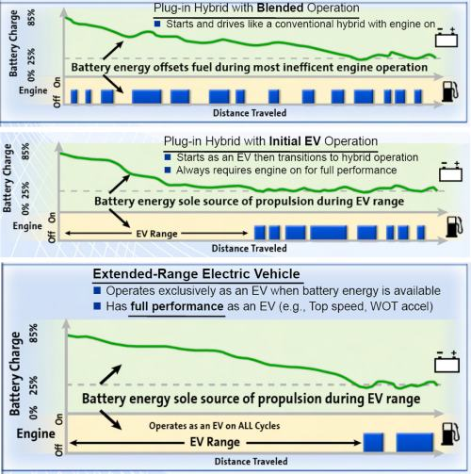

Slide 26
System Architecture
The System Architecture identifies all the products (including enabling products) that are necessary to support the system and, by implication, the processes necessary for development, production/construction, deployment, operations, support, disposal, training, and verification.

